Slide 1



INFO challenge
View in Power BI
Last data refresh:
3/4/2023 2:06:58 AM UTC
Downloaded at:
3/4/2023 5:11:31 AM UTC

Slide 2
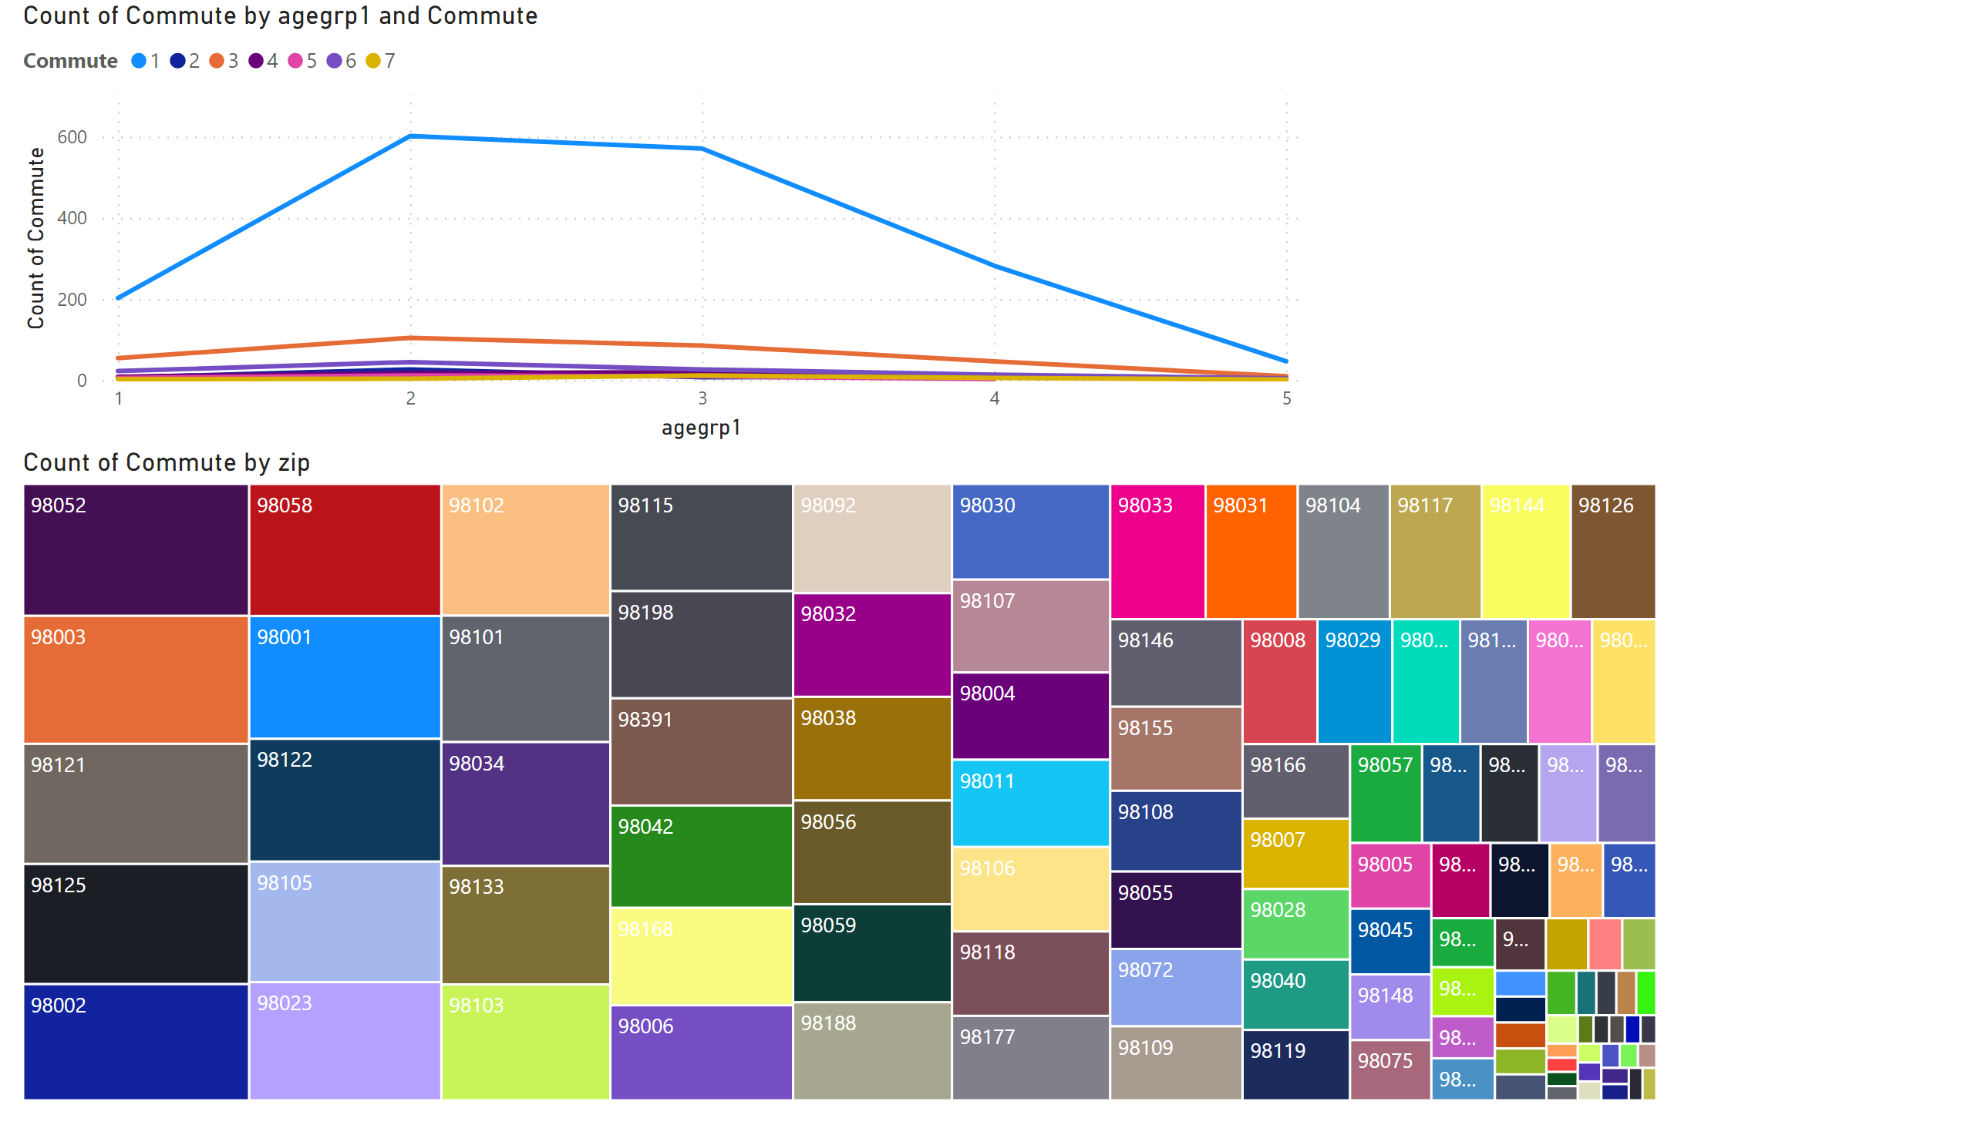
Page 1
Notes:
lineChart
No alt text provided
treemap
No alt text provided

Slide 3
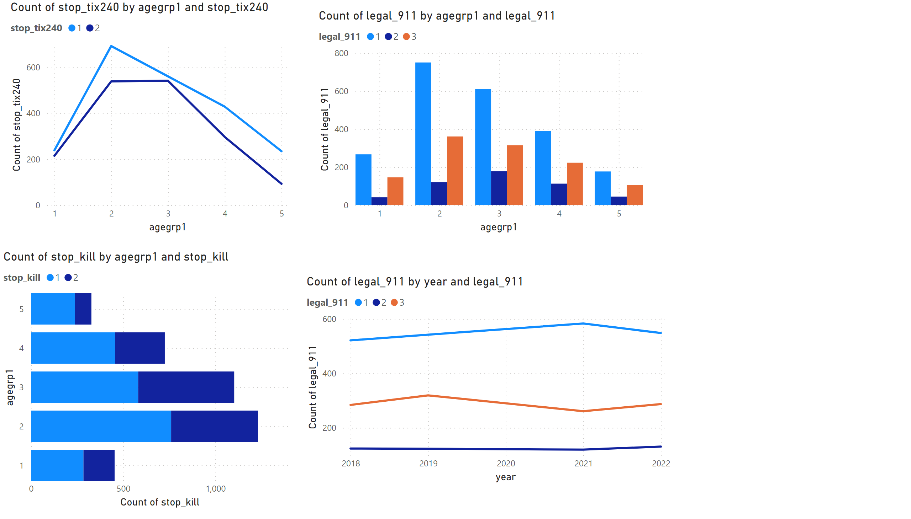
Page 2
Notes:
lineChart
No alt text provided
barChart
No alt text provided
clusteredColumnChart
No alt text provided
lineChart
No alt text provided

Slide 4
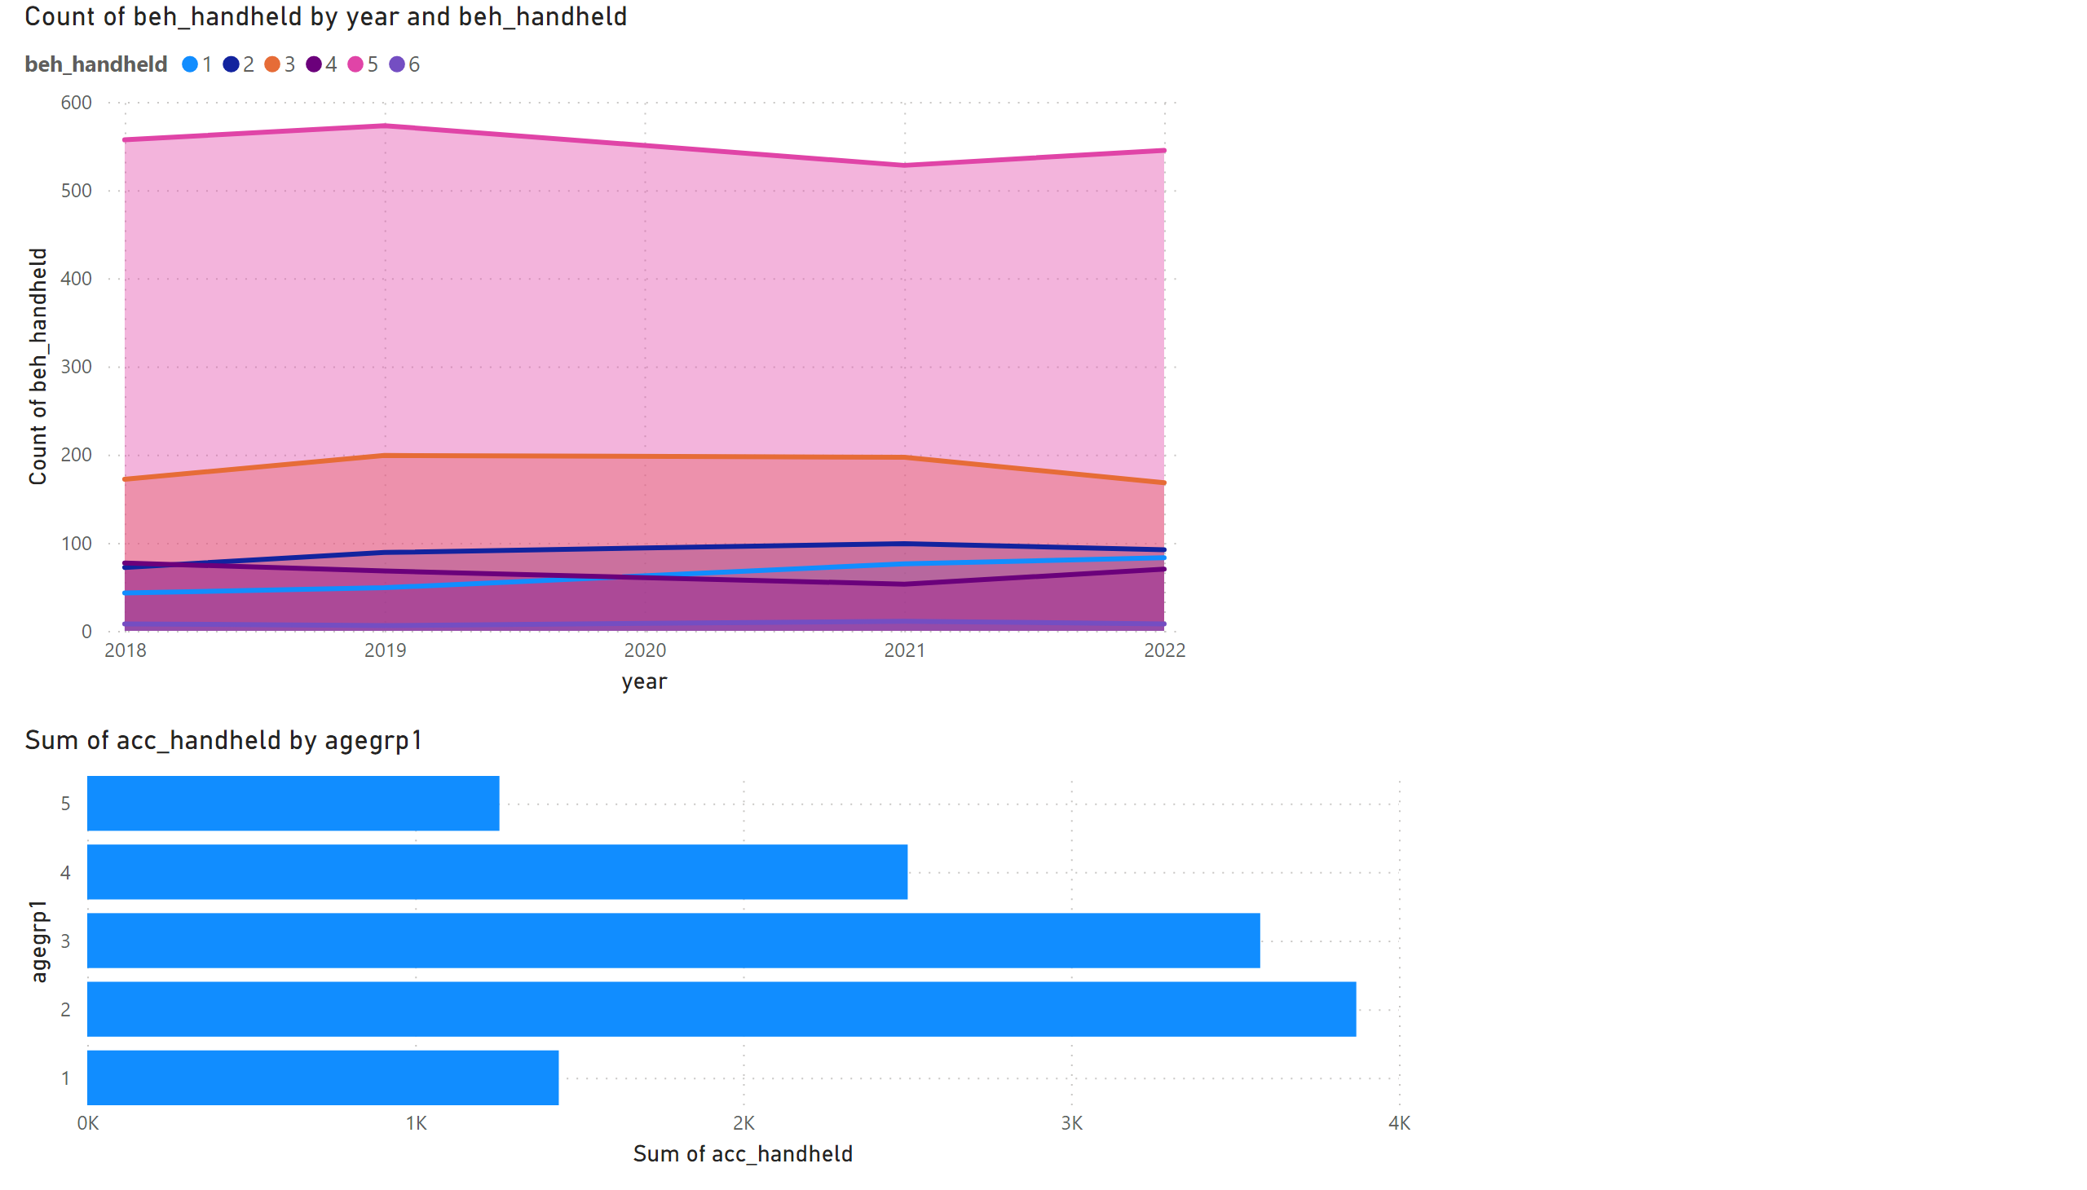
Page 3
Notes:
areaChart
No alt text provided
barChart
No alt text provided

